Slide 1
CompTIA Security+ Guide to Network Security Fundamentals, Sixth Edition
Chapter 8
Wireless Network Security

Slide 2
Objectives
8.1 Describe the different types of wireless network attacks
8.2 List the vulnerabilities in IEEE 802.11 security
8.3 Explain the solutions for securing a wireless network

Slide 3
Wireless Attacks
Several attacks can be directed against wireless data system:
Bluetooth attacks
Near Field Communication (N F C) attacks
Radio frequency identification systems
Wireless local area network attacks

Slide 4
Bluetooth Attacks (1 of 3)
Bluetooth
Wireless technology that uses short-range radio frequency (R F) transmissions
Provides rapid device pairings
Example: smartphone and a Bluetooth mouse
Personal Area Network (P A N) technology
Piconet
Established when two Bluetooth devices come within range of each other
One device (master) controls all wireless traffic
Other device (slave) takes commands
Active slaves are sending transmissions
Parked slaves are connected but not actively participating

Slide 5
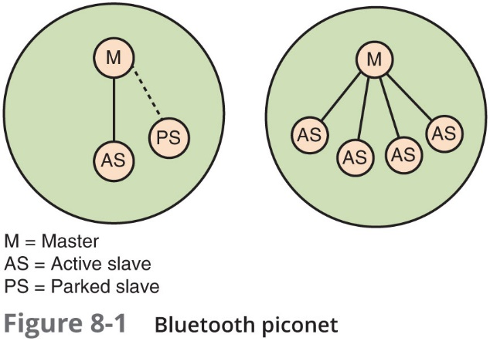
Bluetooth Attacks (2 of 3)

Slide 6
Bluetooth Attacks (3 of 3)
Bluejacking - an attack that sends unsolicited messages to Bluetooth-enabled devices
Text messages, images, or sounds
Bluejacking is considered more annoying than harmful
No data is stolen
Bluesnarfing
An attack that accesses unauthorized information from a wireless device through a Bluetooth connection
Often between cell phones and laptops
Attacker copies e-mails, contacts, or other data by connecting to the Bluetooth device without owner’s knowledge

Slide 7
Near Field Communication (N F C) Attacks (1 of 4)
Near field communication (N F C)
A set of standards used to establish communication between devices in close proximity
Once devices are brought within 4 cm of each other or tapped together, two-way communication is established
Devices using N F C can be active or passive
Passive N F C device – contains information that other devices can read but does not read or receive any information (example, N F C tag)
Active N F C device – can read information as well as transmit data

Slide 8
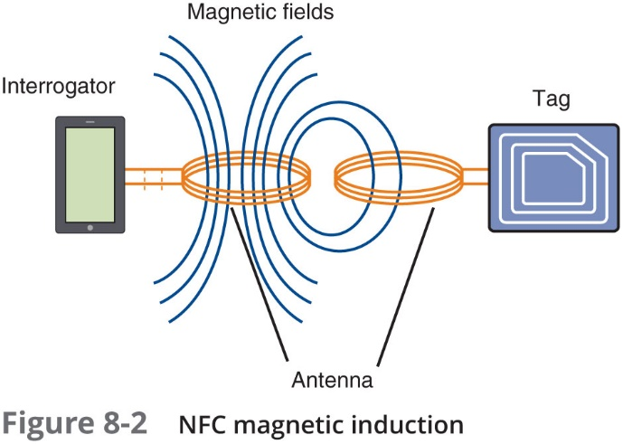
Near Field Communication (N F C) Attacks (2 of 4)

Slide 9
Near Field Communication (N F C) Attacks (3 of 4)
Examples of N F C uses:
Automobile
Entertainment
Office
Retail stores
Transportation
N F C devices are used in contactless payment systems
A consumer can pay for a purchase by simply tapping a store’s payment terminal with their smartphone

Slide 10
Near Field Communication (N F C) Attacks (4 of 4)
Vulnerability | Explanation | Defense
Eavesdropping | Unencrypted N F C communication between the device and terminal can be intercepted and viewed | Because an attacker must be extremely close to pick up the signal, users should remain aware of their surroundings while making a payment
Data theft | Attackers can “bump” a portable reader to a user’s smartphone in a crowd to make an N F C connection and steal payment information stored on the phone | This can be prevented by turning off N F C while in a large crowd
Man-in-the-middle attack | An attacker can intercept the N F C communications between devices and forge a fictitious response | Devices can be configured in pairing so one device can only send while the other can only receive
Device theft | The theft of a smartphone could allow an attacker to use that phone for purchases | Smartphone should be protected with passwords or strong PINs

Slide 11
Radio Frequency Identification (R F I D) Attacks (1 of 2)
Radio frequency identification (R F I D)
Commonly used to transmit information between employee identification badges, inventory tags, book labels, and other paper-based tags that can be detected by a proximity reader
Most R F I D tags are passive
Do not have their own power supply
Because they do not require a power supply, they can be very small
R F I D tags are susceptible to different attacks
Current version of R F I D standards known as Generation 2
Contains some security enhancements over the previous version

Slide 12
Radio Frequency Identification (R F I D) Attacks (2 of 2)
R F I D attack type | Description of attack | Implications of R F I D attack
Unauthorized tag access | A rogue R F I D reader can determine the inventory on a store shelf to track the sales of specific items | Sales information could be used by a rival product manufacturer to negotiate additional shelf space or better product placement
Fake tags | Authentic R F I D tags are replaced with fake tags that contain fictitious data about products that are not in inventory | Fake tags undermine the integrity of the store’s inventory system by showing data for items that do not exist
Eavesdropping | Unauthorized users could listen in on communications between R F I D tags and readers | Confidential data, such as a politician’s purchase of antidepressants, could be sold to a rival candidate in a “smear” campaign

Slide 13
Wireless Local Area Network Attacks
A WLAN is designed to replace or supplement a wired LAN
It is important to know about the:
History and specifications of IEEE WLANs
Hardware necessary for a wireless network
Different types of WLAN attacks directed at enterprise and home users

Slide 14
IEEE WLANs (1 of 3)
Institute of Electrical and Electronics Engineers (IEEE) WLANS
Most influential organization for computer networking and wireless communications
Dates back to 1884
Began developing network architecture standards in the 1980s
1997: release of IEEE 802.11
Standard for wireless local area networks (WLANs)
Higher speeds (5.5 Mbps and 11 Mbps) added in 1999: IEEE 802.11b
IEEE 802.11a
Specifies maximum rated speed of 54Mbps using the 5GHz spectrum

Slide 15
IEEE WLANs (2 of 3)
IEEE 802.11g
Preserves stable and widely accepted features of 802.11b and increases data transfer rates similar to 802.11a
IEEE 802.11n
Ratified in 2009
Improvements: speed, coverage area, resistance to interference, and strong security
IEEE 802.11ac
Ratified in early 2014 and has data rates over 7 Gbps

Slide 16
IEEE WLANs (3 of 3)
blank | 802.11 | 802.11b | 802.11a | 802.11g | 802.11n | 802.11ad | 802.11ac
Frequency | 2.4 GHz | 2.4 GHz | 5 GHz | 2.4 GHz | 2.4 GHz & 5 GHz | 60 GHz | 5 GHz
Maximum data rate | 2 Mbps | 11 Mbps | 54 Mbps | 54 Mbps | 600 Mbps | 7 Gbps | 7.2 Gbps
Indoor range (feet/meters) | 65/20 | 125/38 | 115/35 | 115/35 | 230/70 | 32/10 | 115/35
Outdoor range (feet/meters) | 328/100 | 460/140 | 393/120 | 460/140 | 820/250 | N/A | 460/140
Ratification date | 1997 | 1999 | 1999 | 2003 | 2009 | 2013 | 2014

Slide 17
WLAN Hardware (1 of 3)
Wireless client network interface card adapter
Performs same functions as wired adapter
Antenna sends and receives signals through airwaves
Access point (A P) major parts
Antenna and radio transmitter/receiver send and receive wireless signals
Bridging software to interface wireless devices to other devices
Wired network interface allows it to connect by cable to standard wired network
Access point (A P) functions
Acts as “base station” for wireless network
Acts as a bridge between wireless and wired networks
Can connect to wired network by a cable

Slide 18
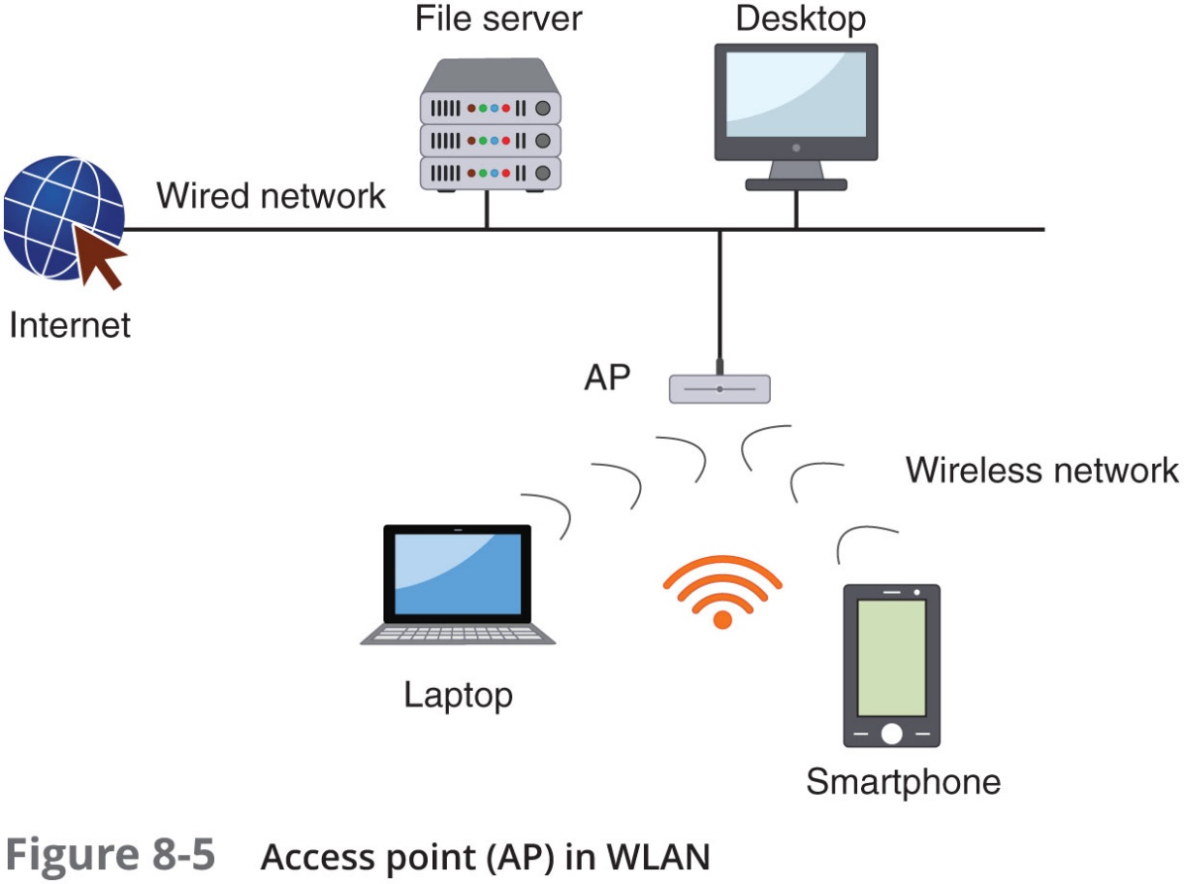
WLAN Hardware (2 of 3)

Slide 19
WLAN Hardware (3 of 3)
A WLAN using an A P is operating in infrastructure mode
Network that are not using an A P operate in ad hoc mode
Devices can only communicate between themselves and cannot connect to another network
The Wi-Fi Alliance has created a similar technical specification called Wi-Fi Direct
Residential WLAN gateway
Used by small offices or home users to connect to the Internet
Features included are A P, firewall, router, dynamic host configuration protocol (D H C P) server, and others

Slide 20
WLAN Enterprise Attacks (1 of 7)
In a network, a well-defined boundary protects data and resources
Boundary is known as a “hard edge”
The introduction of WLANs in enterprises has changed hard edges to “blurred edges”
Types of wireless attacks
Rogue access points
Evil twins
Intercepting wireless data
Wireless replay attacks
Denial of service attacks

Slide 21
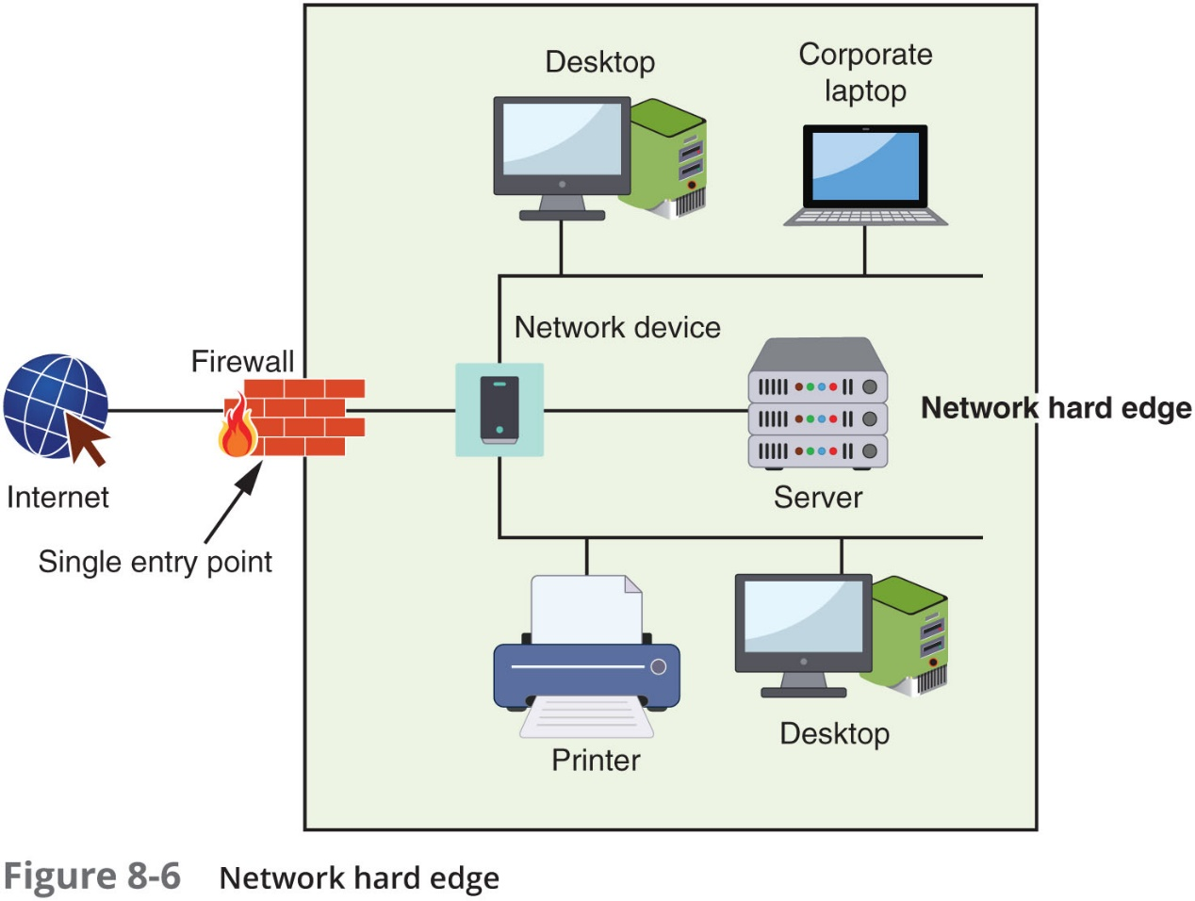
WLAN Enterprise Attacks (2 of 7)

Slide 22
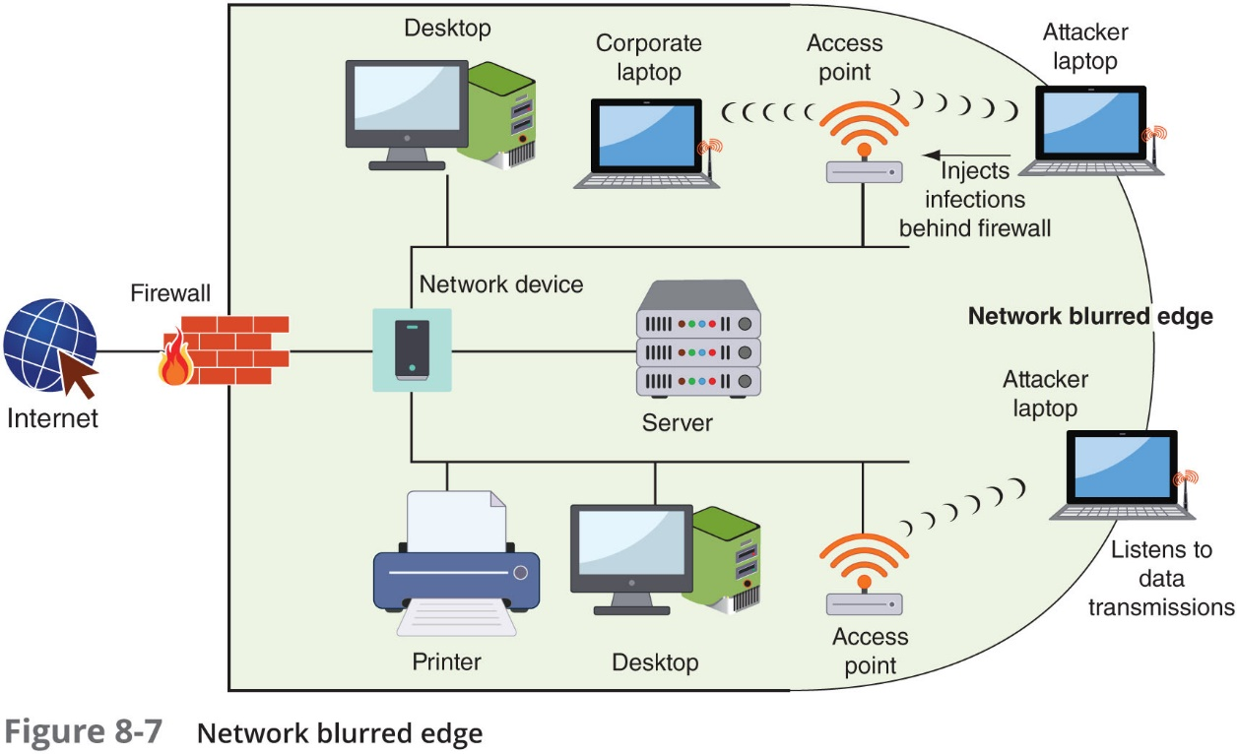
WLAN Enterprise Attacks (3 of 7)

Slide 23
WLAN Enterprise Attacks (4 of 7)
Rogue access point
An unauthorized access point that allows an attacker to bypass network security configurations
Usually set up by an insider (employee)
May be set up behind a firewall, opening the network to attacks
Evil twin
A P set up by an attacker
Attempts to mimic an authorized A P
Attackers capture transmissions from users to evil twin A P

Slide 24
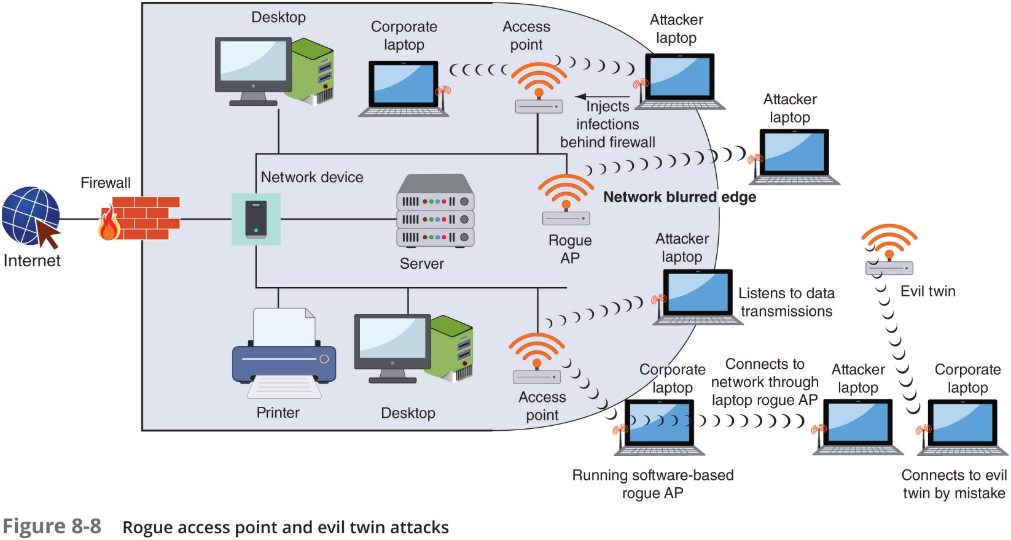
WLAN Enterprise Attacks (5 of 7)

Slide 25
WLAN Enterprise Attacks (6 of 7)
Intercepting Wireless Data
An attacker can pick up the R F signal from an open or misconfigured A P
Using a WLAN to read this data could yield significant information to an attacker regarding the wired enterprise network
Wireless Replay Attack
Also known as “hijacking”
The attacker captures transmitted wireless data, records it, and then sends it on to the original recipient without the attacker’s presence being detected
Can be accomplished using an evil twin A P
Known as a man-in-the-middle attack

Slide 26
WLAN Enterprise Attacks (7 of 7)
Wireless Denial of Service Attack
R F jamming - attackers use intentional R F interference to flood the R F spectrum with enough interference to prevent a device from communicating with the A P
Spoofing - attackers craft a fictitious frame that pretends to come from a trusted client when it actually comes from the attacker
Manipulating duration field values - attackers send a frame with the duration field set to a high value, preventing other devices from transmitting for that period of time
Wireless Home Attacks - most home users fail to configure any security on their home networks
Attackers can:
Steal data
Read wireless transmissions
Inject malware
Download harmful content

Slide 27
Vulnerabilities of IEEE Wireless Security
Original IEEE 802.11 committee recognized wireless transmissions could be vulnerable
Implemented several wireless security protections in the standard
Left others to WLAN vendor’s discretion
Protections were vulnerable and led to multiple attacks

Slide 28
Wired Equivalent Privacy
W E P – an IEEE 802.11 security protocol designed to ensure that only authorized parties can view transmissions
Encrypts plaintext into ciphertext
Secret key is shared between wireless client device and A P
W E P vulnerabilities
W E P can only use 64-bit or 128-bit number to encrypt
Initialization vector (IV) is only 24 of those bits
Short length makes it easier to break
Violates cardinal rule of cryptography: avoid a detectable pattern
Attackers can see duplication when IVs start repeating

Slide 29
Wi-Fi Protected Setup
W P S is an optional means of configuring security on WLANS
Two common W P S methods:
PIN method - utilizes a PIN printed on a sticker of the wireless router or displayed through a software wizard
User enters Pin and security configuration automatically occurs
Push-button method - user pushes buttons and security configuration takes place
Design and implementation flaws:
There is no lockout limit for entering PINs
The last PIN character is only a checksum
The wireless router reports the validity of the first and second halves of the PIN separately

Slide 30
MAC Address Filtering (1 of 3)
Method of controlling WLAN access
Limit a device’s access to AP
Media Access Control (MAC) address filtering
Used by nearly all wireless AP vendors
Permits or blocks device based on MAC address
Vulnerabilities of MAC address filtering
Addresses exchanged in unencrypted format
Attacker can see address of approved device and substitute it on his own device
Managing large number of addresses is challenging

Slide 31
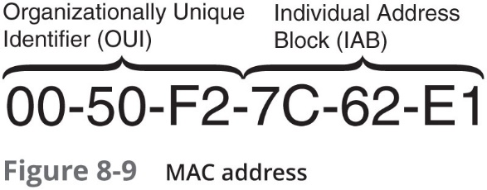
MAC Address Filtering (2 of 3)

Slide 32
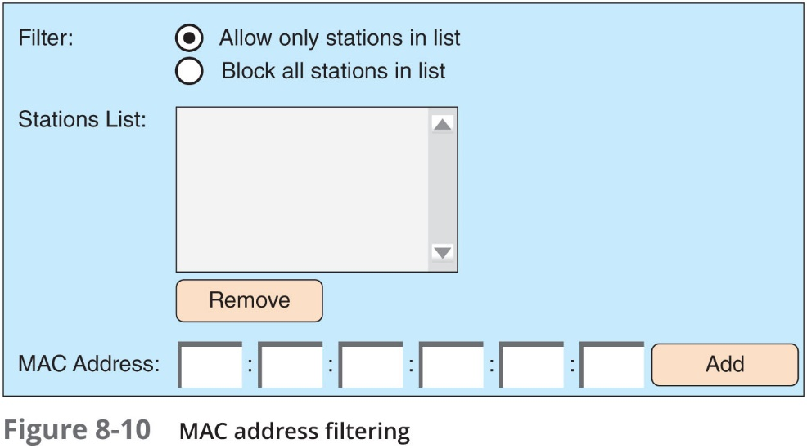
MAC Address Filtering (3 of 3)

Slide 33
S S ID Broadcasting
Service Set Identifier (S S ID)
The user-supplied network name of a wireless network; usually broadcast so that any device can see it
The broadcast can be restricted
Some wireless security sources encourage users to configure their A Ps to prevent the broadcast of the S S ID
Not advertising the S S ID only provides a weak degree of security and has limitations:
S S ID can be discovered when transmitted in other frames
May prevent users from being able to freely roam from one A P coverage area to another
It’s not always possible to turn off SSID beaconing

Slide 34
Wireless Security Solutions
A unified approach to WLAN security was needed
IEEE and Wi-Fi Alliance began developing security solutions
Resulting standards used today
IEEE 802.11i
W P A and W P A 2

Slide 35
Wi-Fi Protected Access (W P A)
Introduced in 2003 by the Wi-Fi Alliance
A subset of IEEE 802.11i
Two modes of WPA:
W P A Personal
W P A Enterprise
W P A addresses both encryption and authentication

Slide 36
Temporal Key Integrity Protocol (T K I P) Encryption
Temporal Key Integrity Protocol (T K I P) Encryption
Used in W P A
Uses a longer 128 bit key than W E P
Dynamically generated for each new packet
Includes a Message Integrity Check (M I C), designed to prevent man-in-the-middle attacks

Slide 37
Preshared Key (P S K) Authentication
Authentication for W P A Personal is accomplished by using a preshared key (P S K)
After A P configured, client device must have same key value entered
Key is shared prior to communication taking place
Uses a passphrase to generate encryption key
Must be entered on each A P and wireless device in advance
Devices that have the secret key are automatically authenticated by the A P

Slide 38
WPA Vulnerabilities
Key management
Key sharing is done manually without security protection
Keys must be changed on a regular basis
Key must be disclosed to guest users
Passphrases
P S K passphrases of fewer than 20 characters subject to cracking

Slide 39
Wi-Fi Protected Access 2 (W P A 2)
Second generation of W P A is known as W P A 2
Introduced in 2004
Based on final IEEE 802.11i standard
Two modes of WPA2:
W P A 2 Personal
W P A 2 Enterprise
Addresses to major security areas of WLANs:
Encryption
Authentication

Slide 40
A E S-C C M P Encryption
Advanced Encryption Standard (A E S) block cipher
A E S performs three steps on every block (128 bits) of plaintext
Within second step, multiple iterations are performed
Bytes are substituted and rearranged
Counter Mode with Cipher Block Chaining Message Authentication Code Protocol (C C M P) is the encryption protocol used for W P A 2
Specifies the use of C C M with A E S
The Cipher Block Chaining Message Authentication Code (C B C-M A C) component of C C M P provides data integrity and authentication
Both C C M P and T K I P use a 128-bit key for encryption
Both methods use a 64-bit M I C value

Slide 41
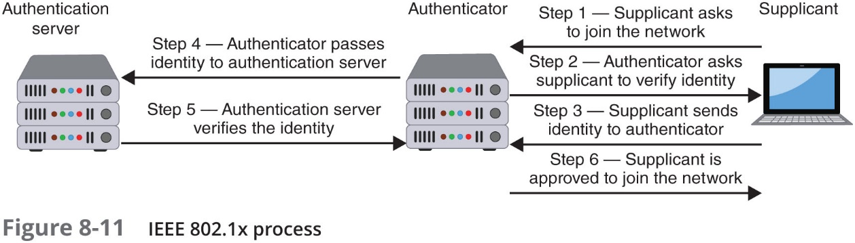
IEEE 802.1x Authentication (1 of 3)
Originally developed for wired networks
Provides greater degree of security by implementing port-based authentication
Blocks all traffic on a port-by-port basis until client is authenticated

Slide 42
IEEE 802.1x Authentication (2 of 3)
Extensible Authentication Protocol (E A P)
A framework for transporting authentication protocols
Defines message format
Uses four types of packets
Request
Response
Success
Failure
A common E A P protocol is Protected E A P (P E A P)
Simplifies deployment of 802.1x by using Microsoft Windows logins and passwords
Creates encrypted channel between client and authentication server

Slide 43
IEEE 802.1x Authentication (3 of 3)
E A P name | Description
E A P-T L S | This protocol uses digital certificates for authentication
E A P-T T L S | This protocol securely tunnels client password authentication within Transport Layer Security (T L S) records
E A P-F A S T | This protocol securely tunnels any credential form for authentication (such as a password or a token) using T L S

Slide 44
Additional Wireless Security Protections
Other security steps can be taken:
Rogue A P system detection
Using the correct type of A P
A P configuration settings
Wireless peripheral protection

Slide 45
Rogue A P System Detection
Rouge A P Discovery Tools - 4 types of wireless probes can monitor airwaves for traffic:
Wireless device probe
Desktop probe
Access point probe
Dedicated probe
Once a suspicious signal is detect by a wireless probe
The information is sent to a centralized database where WLAN management system software compares it to a list of approved A Ps
Any device not on the list is considered a rogue A P

Slide 46
A P Type (1 of 4)
A P types can be divided into:
Fat vs. thin
Controller vs. standalone
Captive portal A Ps
Fat (Thick) vs. Thin A Ps
Autonomous A Ps have the intelligence required to manage wireless authentication, encryption, and other functions for the wireless devices they serve (called Fat or Thick A Ps)
“Lightweight” A Ps do not contain all the management and configuration functions found in fat A Ps (called Thin A Ps)

Slide 47
A P Type (2 of 4)
Standalone vs. Controller A Ps
Controller A Ps can be managed through a dedicated wireless LAN controller (W L C)
The W L C is the single device that can be configured and settings are automatically distributed to all controller A Ps
Other advantages of controller A Ps:
Handoff procedure is eliminated because all authentications are performed in the W L C
Offers tools that provide for monitoring the environment and providing information regarding the best locations for A Ps, wireless A P configuration settings, and power settings

Slide 48
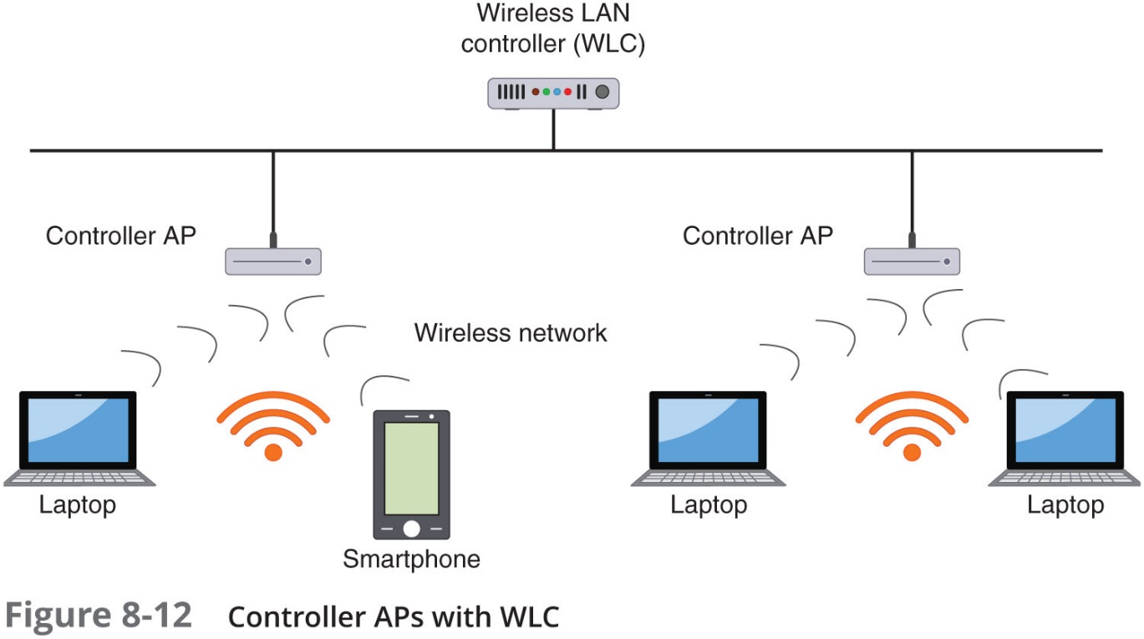
A P Type (3 of 4)

Slide 49
A P Type (4 of 4)
Captive Portal A Ps
Uses a standard web browser to provide information
Gives the wireless user the opportunity to agree to a policy or present valid login credentials

Slide 50
A P Configuration and Device Options (1 of 3)
Other A P configuration settings are designed to limit the spread of the wireless R F signal
So that a minimum amount of signal extends past the physical boundaries of the enterprise to be accessible to outsiders
Site Surveys
An in-depth examination and analysis of a wireless LAN site

Slide 51
A P Configuration and Device Options (2 of 3)
Signal Strength Settings
Some A Ps allow adjustment of the power level at which the LAN transmits
Reducing power allows less signal to reach outsiders
Spectrum Selection
Some A Ps provide the ability to adjust frequency spectrum settings, including:
Frequency band
Channel selection
Channel width

Slide 52
A P Configuration and Device Options (3 of 3)
Antennas
A P should be located near the center of coverage area
Place high on a wall to reduce signal obstructions and deter theft
If possible, the A P and antenna should be positioned so that a minimal amount of signal reaches beyond the security perimeter of the building
Wireless Peripheral Protection
Vulnerabilities in wireless mice and keyboards are common
One attack could let a threat actor inject mouse movements or keystrokes from a nearby antenna up to 100 yards away
Protections include:
Updating or replacing any vulnerable devices
Switching to more fully tested Bluetooth mice and keyboards
Substitute with a wired mouse or keyboard

Slide 53
Review Questions
Which of these Bluetooth attacks involves accessing unauthorized information through a Bluetooth connection?
A. Bluesnarfing
B. Bluejacking
C. Bluecreeping
D. Bluestealing
The primary design of a(n) _____ is to capture the transmissions from legitimate users.
A. rogue access point
B. WEP
C. evil twin
D. Bluetooth grabber
AES-CCMP is the encryption protocol standard used in _____.
A. WPA
B. WPA2
C. IEEE 802.11
D. NFC

Slide 54
Chapter Summary (1 of 3)
Bluetooth is a wireless technology using short-range R F transmissions
Near field communication (N F C) is a set of standards primarily for smartphones and smartcards used to communicate with devices in close proximity
A wireless technology similar to N F C is radio frequency identification (R F I D)
A wireless local area network (WLAN) is designed to replace or supplement a wired LAN
The IEEE has developed standards for WLANs
A rouge A P is an unauthorized A P that allows an attacker to bypass network security and open the network and its users to attacks

Slide 55
Chapter Summary (2 of 3)
IEEE 802.11 committee implemented several wireless security protections in the 802.11 standard
W E P and W P S, however, have significant design and implementation flaws
Controlling access to the WLAN can be accomplished using M A C filtering on the A P
Wi-Fi Protected Access (W P A) and W P A 2 have become the foundations of wireless security today
Extensible Authentication Protocol (E A P) is a framework for transporting authentication protocols by defining the format of the messages

Slide 56
Chapter Summary (3 of 3)
Other steps to protect a wireless network include:
Detecting rogue access points
Choose the best type of A P to match the needs of the network
Manage A Ps through a wireless LAN controller (W L C)
Use a captive portal A P
Access point power level adjustment
Antenna positioning

